Slide 1

AASD 4016
Full Stack Data Science Systems
Applied AI Solutions Developer Program

Slide 2
Module 1
Scripting Notebooks
Vejey Gandyer

Slide 3
Agenda
Python Notebooks
Python Scripts
IDE
Scripting process
Examples

Slide 4
Python Notebooks
.ipynb

Slide 5
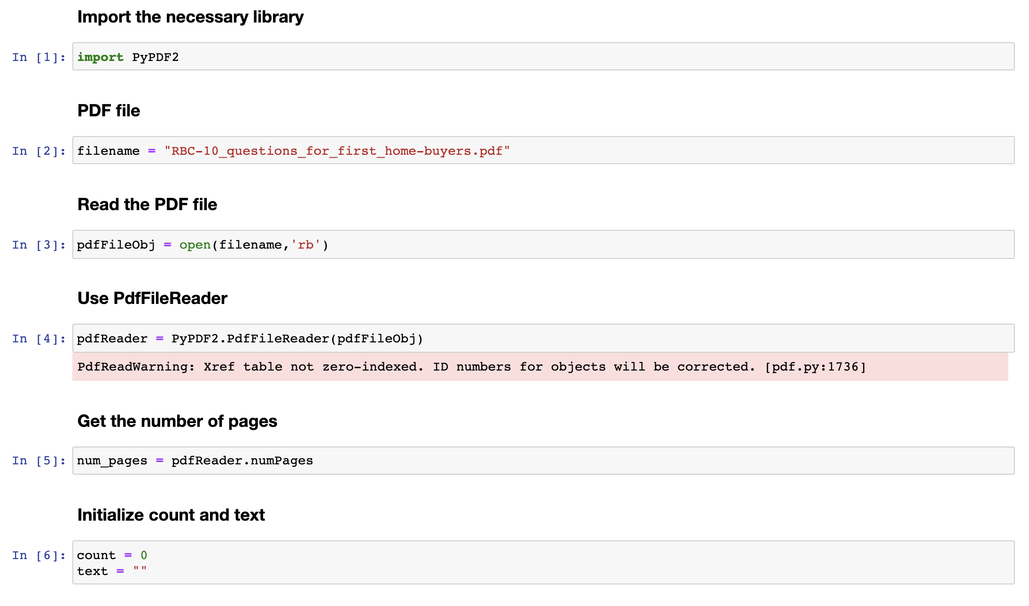
IPython Notebook

Slide 6
Python Scripts
.py

Slide 7
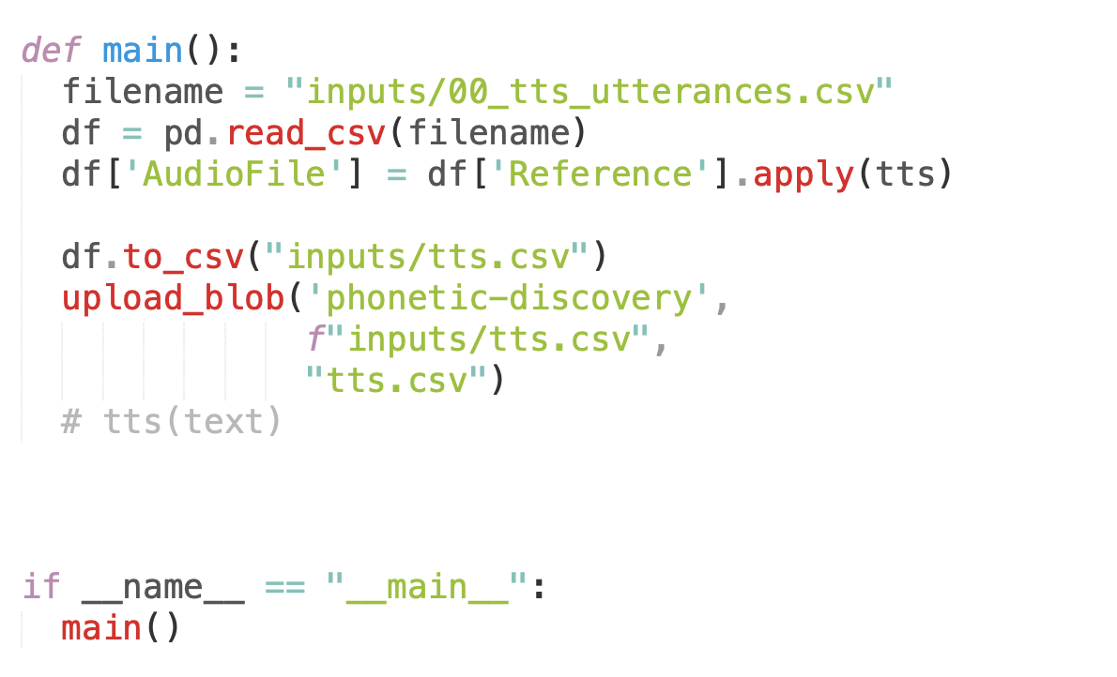
Python Script

Slide 8
IDE
VSCode
Sublime Text
Atom
Vim
Spyder

Slide 9
Integrated Development Environment
VSCode
Atom
Sublime Text
Spyder
Vim

Slide 10
Scripting Process
.ipynb to .py

Slide 11
Scripting Process
IPython Notebooks (.ipynb) to be converted into Python Scripts (.py)
Pros
Works well in Production environment
Can be run from terminal
Can be made as an API to be served to consumers

Slide 12
Process
See what is the problem that the notebook trying to solve
Find the inputs and outputs of the entire problem
Find the steps to solve that problem
Create an app.py file
Place the notebook cells in the app.py file
Clean the app.py file
Remove display of variables
Find a way to modularize the above found steps into smaller functions
Place the functions in different python scripts (if possible and makes sense)
Import those functions in the app.py
Once app.py is clean and finished, run it in the terminal
python app.py

Slide 13
Examples
01_Scripting_Notebook.ipynb to 01_app.py
02_Scripting_Notebook.ipynb to 02_app.py
03_Scripting_Notebook.ipynb to 03_app.py

Slide 14
Example 1 Scripting Process
01_Scripting_Notebook.ipynb
Look at the example notebook
PDF file to Text file Conversion
01_app.py
Blank python script (to be filled from the notebook)

Slide 15
Example 2 Scripting Process
02_Scripting_Notebook.ipynb
Look at the example notebook
02_app.py
Blank python script to be filled from the notebook

Slide 16
Example 3 Scripting Process
03_Scripting_Notebook.ipynb
Look at the example notebook
03_app.py
Blank python script to be filled from the notebook

